Slide 1
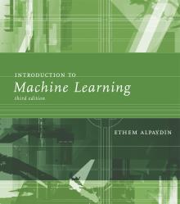
INTRODUCTION TO Machine Learning 3rd Edition
Lecture Slides for
ETHEM ALPAYDIN
© The MIT Press, 2014
alpaydin@boun.edu.tr
http://www.cmpe.boun.edu.tr/~ethem/i2ml3e

Slide 2
CHAPTER 15: Hidden Markov Models

Slide 3
Introduction
Modeling dependencies in input; no longer iid
Sequences:
Temporal: In speech; phonemes in a word (dictionary), words in a sentence (syntax, semantics of the language).
In handwriting, pen movements
Spatial: In a DNA sequence; base pairs

Slide 4
Discrete Markov Process
N states: S₁, S₂, ..., S_{N} State at “time” t, q_{t} = S_{i}
First-order Markov
P(q_{t+1}=S_{j} | q_{t}=S_{i}, q_{t-1}=S_{k} ,...) = P(q_{t+1}=S_{j} | q_{t}=S_{i})
Transition probabilities
a_{ij} ≡ P(q_{t+1}=S_{j} | q_{t}=S_{i}) a_{ij} ≥ 0 and Σ_{j=1}^{N} a_{ij}=1
Initial probabilities
π_{i} ≡ P(q₁=S_{i}) Σ_{j=1}^{N} π_{i}=1

Slide 5
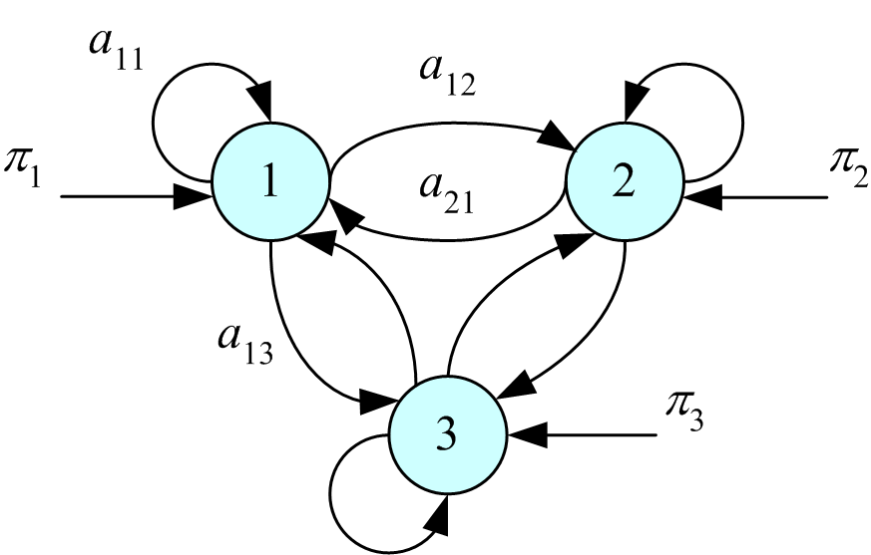
Stochastic Automaton

Slide 6
Example: Balls and Urns
Three urns each full of balls of one color
S₁: red, S₂: blue, S₃: green

Slide 7
Balls and Urns: Learning
Given K example sequences of length T

Slide 8
Hidden Markov Models
States are not observable
Discrete observations {v₁,v₂,...,v_{M}} are recorded; a probabilistic function of the state
Emission probabilities
b_{j}(m) ≡ P(O_{t}=v_{m} | q_{t}=S_{j})
Example: In each urn, there are balls of different colors, but with different probabilities.
For each observation sequence, there are multiple state sequences

Slide 9
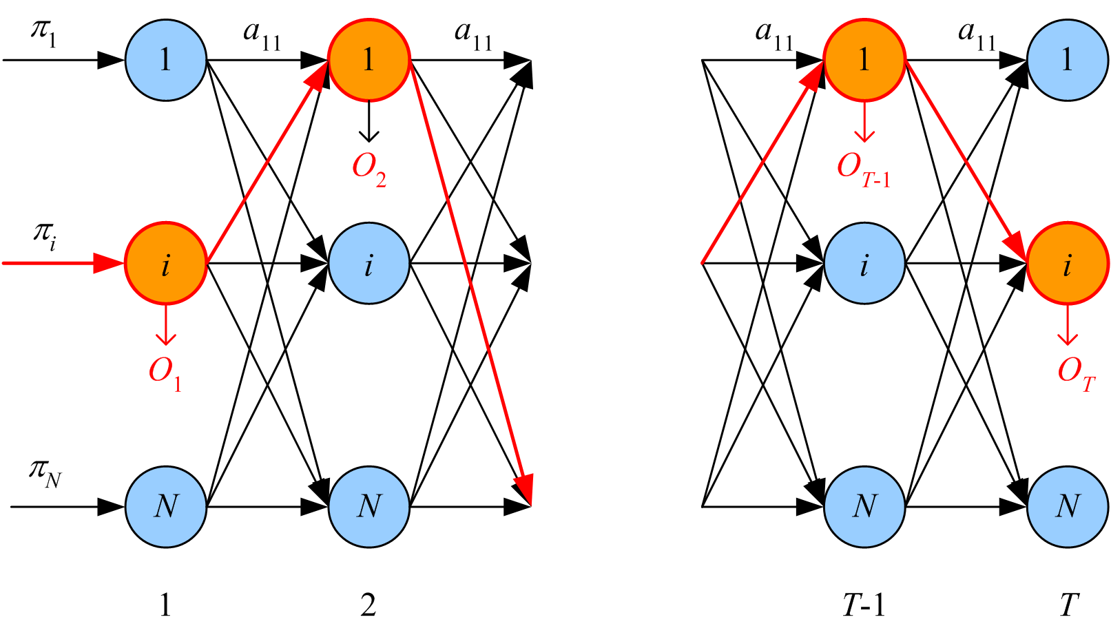
HMM Unfolded in Time

Slide 10
Elements of an HMM
N: Number of states
M: Number of observation symbols
A = [a_{ij}]: N by N state transition probability matrix
B = b_{j}(m): N by M observation probability matrix
Π = [π_{i}]: N by 1 initial state probability vector
λ = (A, B, Π), parameter set of HMM

Slide 11
Three Basic Problems of HMMs
Evaluation: Given λ, and O, calculate P (O | λ)
State sequence: Given λ, and O, find Q* such that
P (Q* | O, λ ) = max_{Q} P (Q | O , λ )
Learning: Given X={O^{k}}_{k}, find λ* such that
P ( X | λ* )=max_{λ} P ( X | λ )
(Rabiner, 1989)

Slide 12
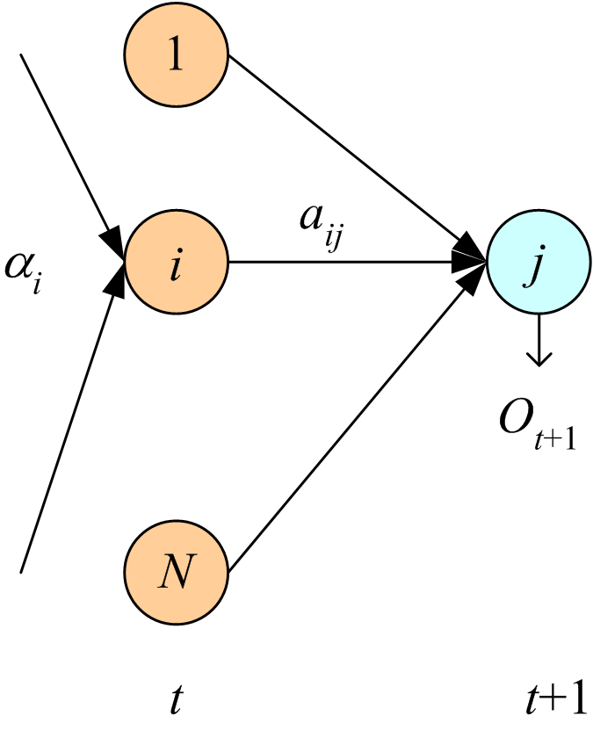
Evaluation
Forward variable:

Slide 13
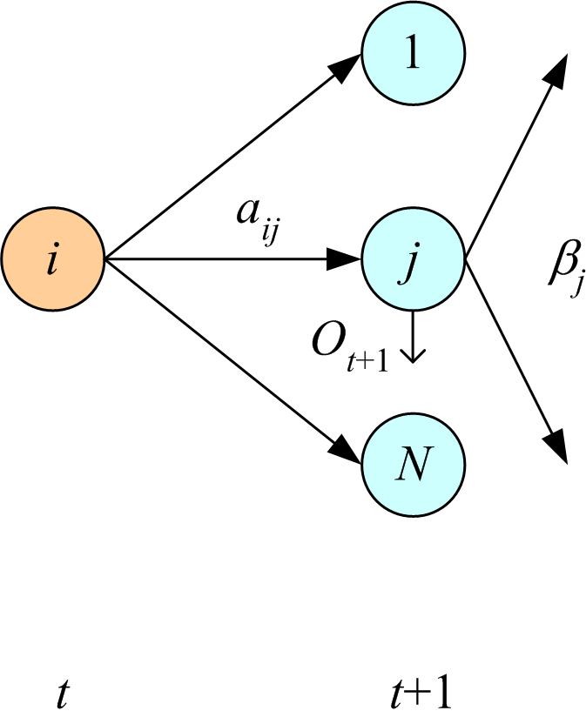
Backward variable:

Slide 14
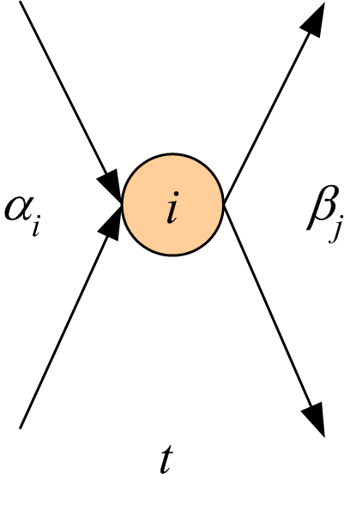
Finding the State Sequence
Choose the state that has the highest probability,
for each time step:
q_{t}*= arg max_{i} γ_{t}(i)
No!

Slide 15
Viterbi’s Algorithm
δ_{t}(i) ≡ max_{q1q2∙∙∙ qt-1} p(q₁q₂∙∙∙q_{t-1},q_{t} =S_{i},O₁∙∙∙O_{t} | λ)
Initialization:
δ₁(i) = π_{i}b_{i}(O₁), ψ₁(i) = 0
Recursion:
δ_{t}(j) = max_{i} δ_{t-1}(i)a_{ij}b_{j}(O_{t}), ψ_{t}(j) = argmax_{i} δ_{t-1}(i)a_{ij}
Termination:
p* = max_{i} δ_{T}(i), q_{T}*= argmax_{i} δ_{T} (i)
Path backtracking:
q_{t}* = ψ_{t+1}(q_{t+1}* ), t=T-1, T-2, ..., 1

Slide 16
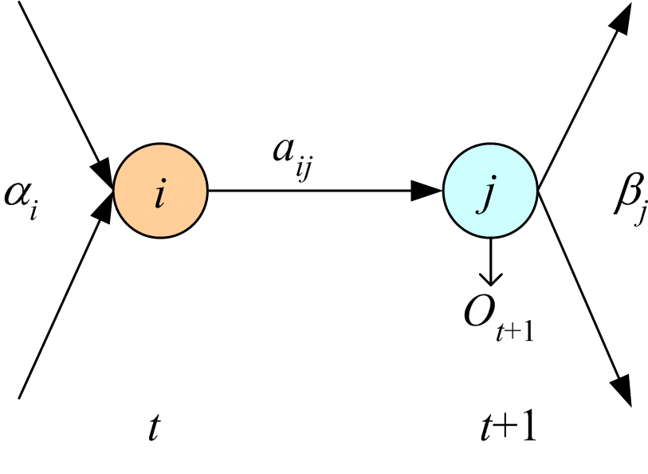
Learning

Slide 17
Baum-Welch (EM)

Slide 18
Continuous Observations
Discrete:
Gaussian mixture (Discretize using k-means):
Continuous:
Use EM to learn parameters, e.g.,

Slide 19
HMM with Input
Input-dependent observations:
Input-dependent transitions (Meila and Jordan, 1996; Bengio and Frasconi, 1996):
Time-delay input:

Slide 20
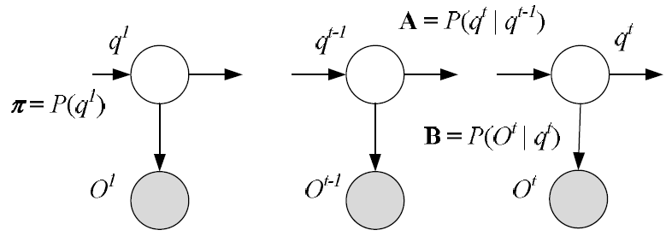
HMM as a Graphical Model

Slide 21
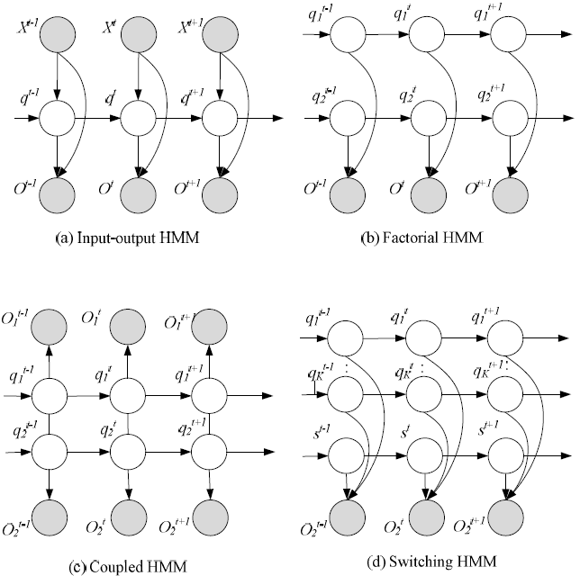

Slide 22
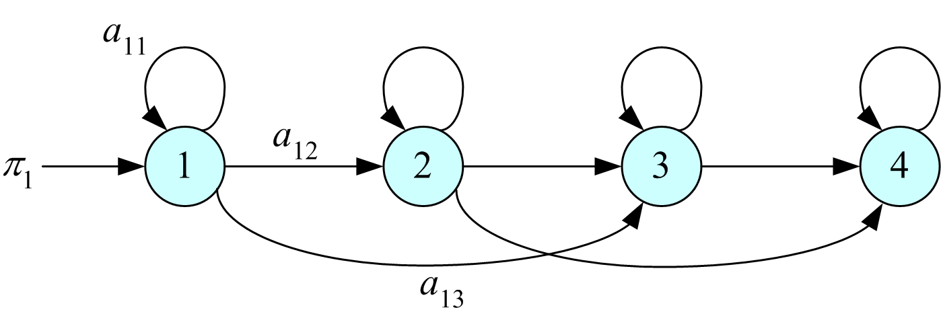
Model Selection in HMM
Left-to-right HMMs:
In classification, for each C_{i}, estimate P (O | λ_{i}) by a separate HMM and use Bayes’ rule

